Slide 1
CAP STORE Shipping Status
DURGA SAI SUSHMA CH
EmpId:190060

Slide 2
Contents:
About Capstore
About the module
Working of the module
Code Snippet
Output
Conclusion

Slide 3
About CapStore:
CapStore is a web based e-commerce website that allows users to buy products.
Users can view products from different categories and buy them .
This site gives a feel of already established e-commerce websites like Flipkart, Amazon etc.

Slide 4
About the module:
Admin will update the status of delivery of products.
Customer can check status of delivery.

Slide 5
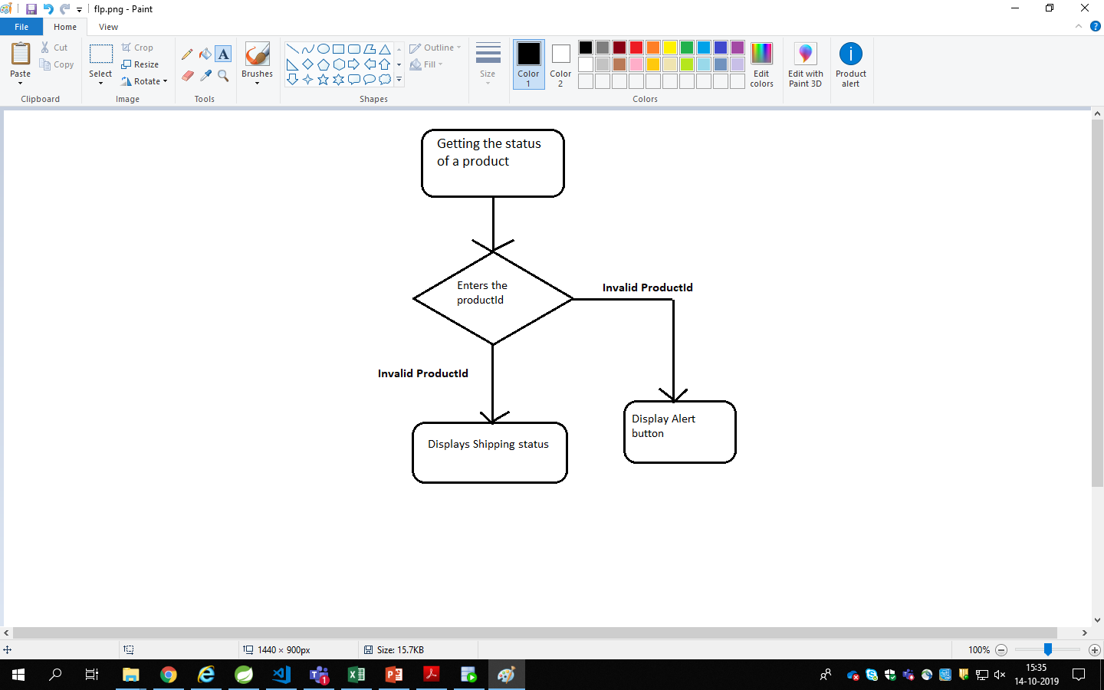
Working of the module:

Slide 6
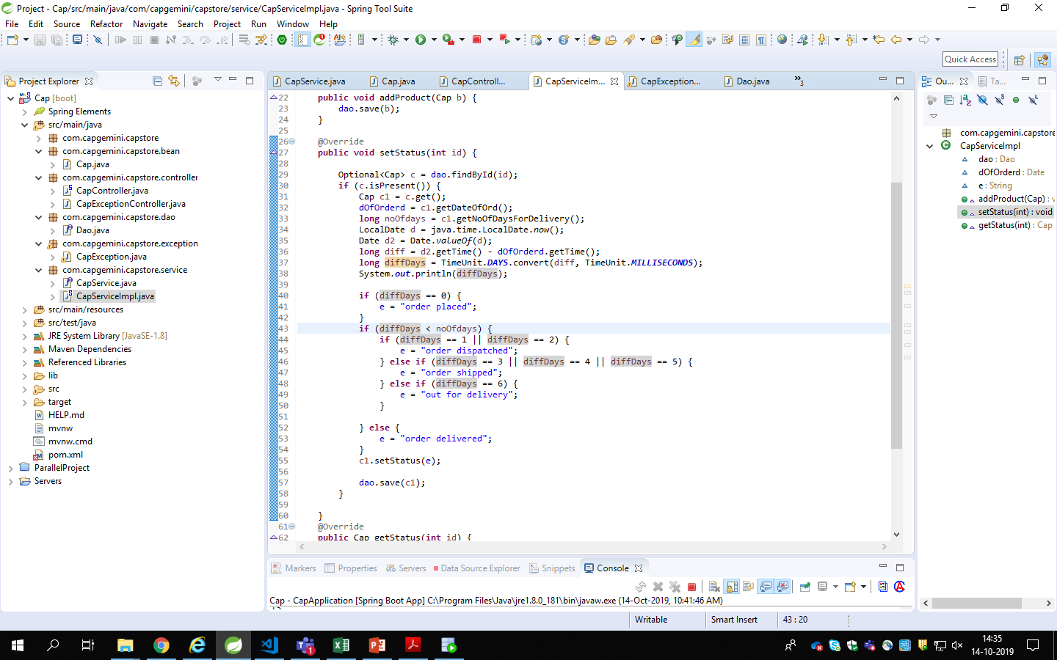
Code snippet:

Slide 7
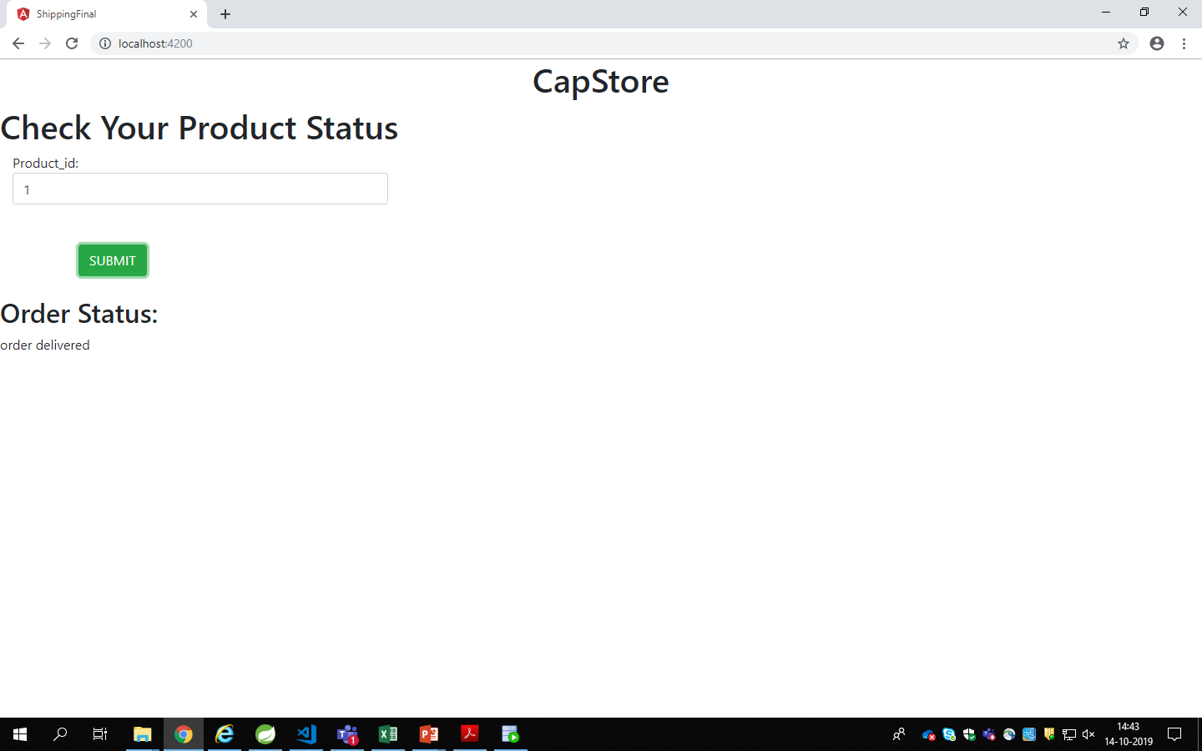
Output:

Slide 8
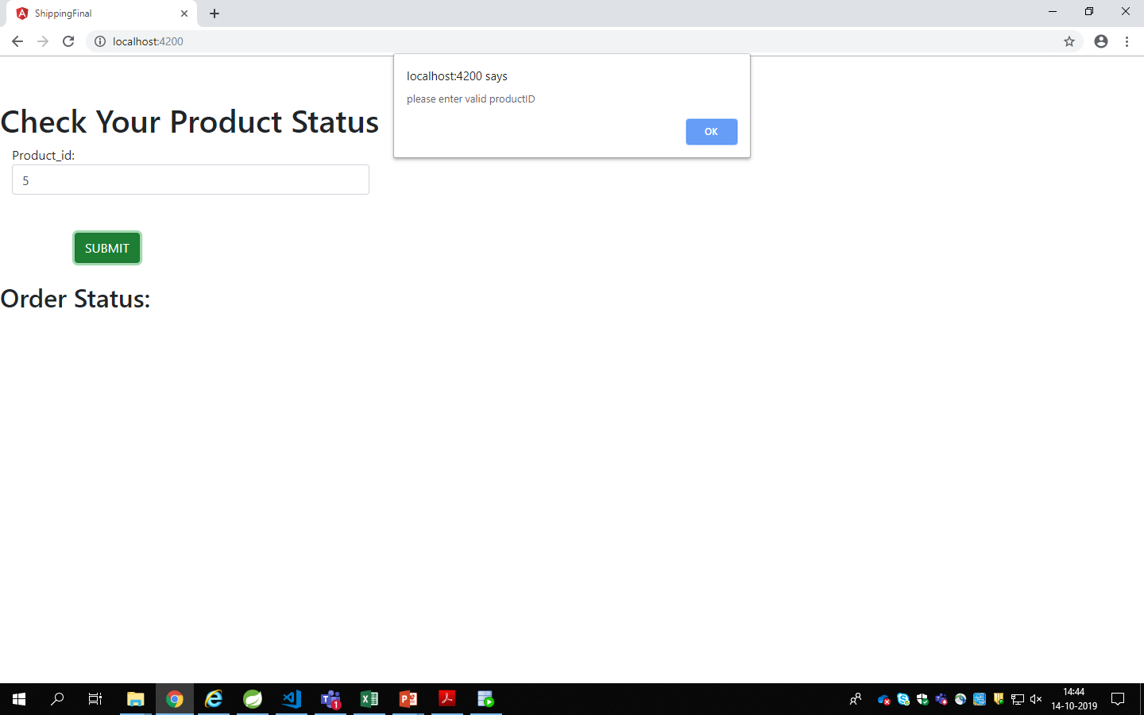
Output:

Slide 9
Software requirements:
Spring Tool Suite
Visual Studio Code
Oracle SQL Developer

Slide 10
Conclusion:

Slide 11
THANK YOU

